Slide 1

Phising URL Detection
Cycbe security
TECHNOLOGY PRESENTATIONS

Slide 2

Phising URL Detection
Thực trạng
Quy trình giải quyết
Kết quả mang lại
Bài toán cần giải
Đối tượng người dùng
Lợi ích mang lại cho người dùng
Thu thập dữ liệu
Xử lí, tiền dữ liệu
Khai phá dữ liệu, lựa chọn mô hình học máy
Học máy
Kiểm thử đánh giá
Kết quả của quá trình nghiên cứu học máy
Kết quả cá nhân và doanh nghiệp thu lại được

Slide 3

Bài toán cần giải
Thực trạng
Hiện nay
Vào năm 2020 có hơn 5000 cuộc tấn an ninh mạng tại việt nam
Tại úc nhưng cuộc tấn công mạng trong năm 2022 đem lại thiệt hai ước tính 33 tỷ USD
Làm thế nào để giảm thiểu thiệt hại
Đôi tượng sử dụng
Mọi cá nhân tham gia truy cập internet đều là đối tượng có thể bị tấn công
Các doanh nghiệp, tổ chức và chính phủ đều rất quan tâm đến an ninh không gian mạng

Slide 4

Quy trình giải quyết
Thu thập dữ liệu
Xử lí, tiền dữ liệu
Khai phá dữ liệu, lựa chọn mô hình học máy
Học máy
Kiểm thử đánh giá
phising_URLs_detection.ipynb - Colaboratory (google.com)

Slide 5


KẾT QUẢ
KẾT QUẢ QUÁ TRÌNH HỌC MÀY
Good Model:
Accuracy:
Precision:
Recall:
Hiệu quả đem lại người dùng
Nếu sử dụng mô hình của chúng tôi sẽ giảm thiểu 75% nguy cơ bị tân công mạng qua URL

Slide 6



Manufacturers
MINH TRẦN
MENTOR
Hiếu Lê
HUY MẠNH

Slide 7
THANK YOU
FOR WATCHING!

Slide 8
WELCOME TO PRESENTATION
I'm Rain, and I'll be sharing with you my beautiful ideas.
Follow me at @reallygreatsite to learn more.

Slide 9

MISSION
VISION
Enter your grand
vision statement!
Enter your grand
vision statement!

Slide 10



GALLERY IMAGE
What can you say about your projects? Share it here!

Slide 11
ADD A TABLE
ADD A MAIN POINT Briefly elaborate on what you want to discuss. | ADD A MAIN POINT Briefly elaborate on what you want to discuss. | ADD A MAIN POINT Briefly elaborate on what you want to discuss.
ADD A MAIN POINT Briefly elaborate on what you want to discuss. | ADD A MAIN POINT Briefly elaborate on what you want to discuss. | ADD A MAIN POINT Briefly elaborate on what you want to discuss.

Slide 12
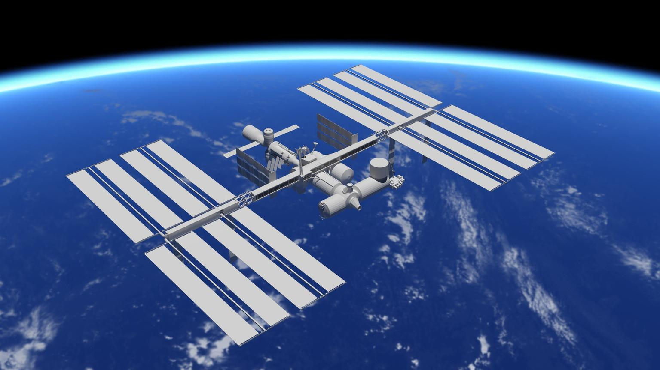

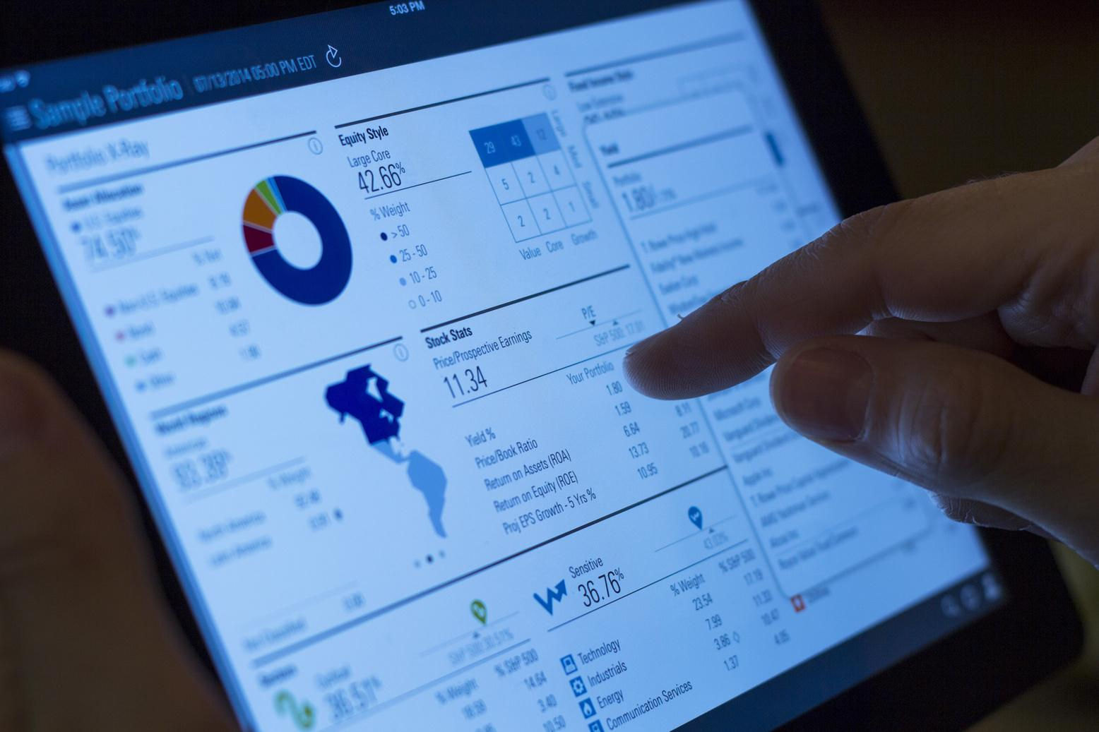
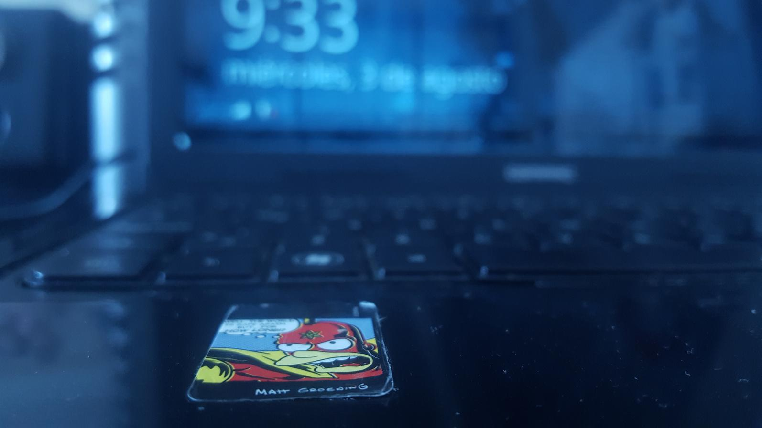
Briefly elaborate on what you want to discuss.
Briefly elaborate on what you want to discuss.
WRITE YOUR IDEA
Briefly elaborate on what you want to discuss.
Briefly elaborate on what you want to discuss.

Slide 13

WRITE AN ORIGINAL STATEMENT OR INSPIRING QUOTE
— include a credit, citation, or supporting message

Slide 14




ADD A TEAM MEMBERS PAGE
NAME
NAME
Title or Position
Title or Position
Elaborate on what you
want to discuss.
NAME
NAME
Title or Position
Title or Position

Slide 15


OUR PROJECTS
Elaborate on what you want to discuss.

Slide 16

YOUR PROJECT
Presentations are communication tools that can be used as demonstrations, lectures, speeches, reports, and more. It is mostly presented before an audience. It serves a variety of purposes, making presentations powerful tools for convincing and teaching.
YEAR: 2022
ROLE: WRITE YOUR ROLE

Slide 17

A PICTURE IS WORTH A THOUSAND WORDS

Slide 18
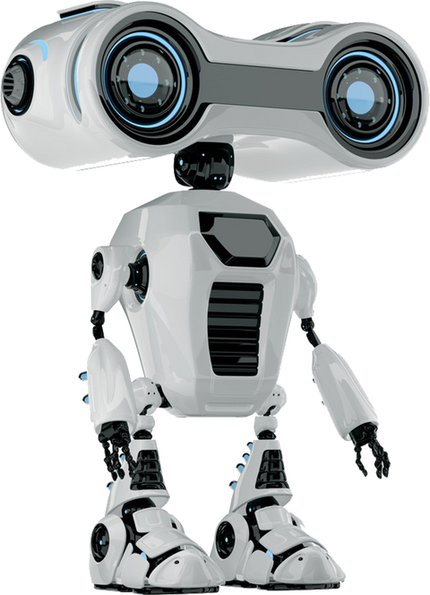

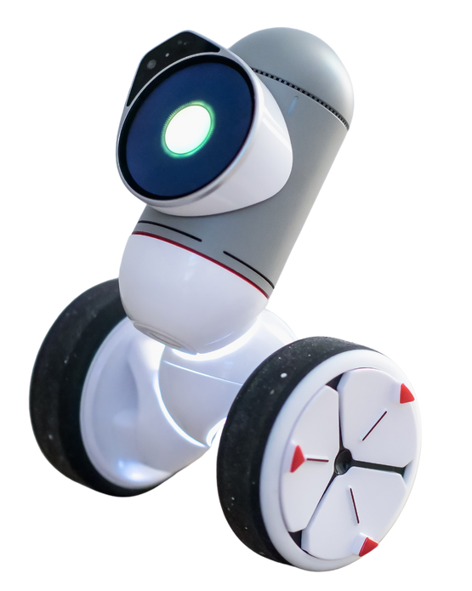
WRITE YOUR TOPIC OR IDEA
ADD A MAIN POINT
ADD A MAIN POINT
ADD A MAIN POINT
Briefly elaborate on what you want to discuss.
Briefly elaborate on what you want to discuss.
Briefly elaborate on what you want to discuss.

Slide 19

OUR SERVICES
SERVICE ONE
SERVICE TWO
SERVICE THREE
SERVICE FOUR
Elaborate on what you want to discuss.
Elaborate on what you want to discuss.
Elaborate on what you want to discuss.
Elaborate on what you want to discuss.

Slide 20

Presentations are communication tools that can be used as demonstrations, lectures, speeches, reports, and more.
WRITE YOUR BIG TOPIC OR IDEA
It serves a variety of purposes, making presentations powerful tools for convincing and teaching.

Slide 21

20$
ADD A
PRICING PAGE
Add a feature
Add a feature
MONTHLY
30$
Add a feature
Add a feature
Add a feature
MONTHLY
300$
Add a feature
Add a feature
Add a feature
Add a feature
YEARLY

Slide 22

STATS & NUMBERS
Elaborate on what you want to discuss.

Slide 23

123,456,789
Elaborate on the featured statistic.

Slide 24
2 OUT OF 5
Elaborate on the featured statistic.
95%
Elaborate on the featured statistic.
12 MILLION
Elaborate on the featured statistic.

Slide 25
INFOGRAPHIC SLIDE REPORT
Elaborate on the featured statistic.
Elaborate on the featured statistic.
Elaborate on the featured statistic.
43%
60%
35%
Elaborate on the featured statistic

Slide 26
WRITE YOUR TOPIC OR IDEA
50
40
30
Elaborate on the
featured statistic.
20
10
0
Item 1
Item 2
Item 3
Item 4
Item 5

Slide 27
ADD A TIMELINE PAGE
Add a main point
Add a main point
Add a main point
Add a main point
Elaborate on what you want to discuss.
Elaborate on what you want to discuss.
Elaborate on what you want to discuss.
Elaborate on what you want to discuss.

Slide 28
STRENGTHS | WEAKNESSES | OPPORTUNITIES | THREATS
What are you doing well? What sets you apart? What are your good qualities? | Where do you need to improve? Are resources adequate? What do others do better than you? | What are your goals? Are demands shifting? How can it be improved? | What are the blockers you're facing? What are factors outside of your control?
S
W
O
T

Slide 29







ADD A CHART PAGE
Name
Job Title
Name
Job Title
Name
Job Title
Name
Job Title
Name
Job Title
Name
Job Title
Name
Job Title
Name
Job Title
Name
Job Title

Slide 30






CONTACT US
123 Anywhere St., Any City,ST 12345
123-456-7890
hello@reallygreatsite.com
@reallygreatsite
reallygreatsite.com

Slide 31


CREDITS
This presentation template is free for everyone to use thanks to the following:
SlidesCarnival for the presentation template
Pexels for the photos
HAPPY DESIGNING!

Slide 32

FONTS IN THIS PRESENTATION
This presentation template uses the following free fonts:
Titles: Teko Medium
Headers: Montserrat
Body Copy: Montserrat
You can find these fonts online too.
Happy designing!

Slide 33

For PowerPoint, Google Slides,
and Canva
FREE TEMPLATES
FOR ALL YOUR PRESENTATION NEEDS
100% free for personal or commercial use
Ready to use, professional, and customizable
Blow your audience away with
attractive visuals

Slide 34







































RESOURCE
PAGE
Use these design resources in your Canva Presentation. Happy designing!
Don't forget to delete this page before presenting.

